Slide 1
FLOOD WARNING SYSTEMS
Name : Nguyen Dinh Long

Slide 2

I. INTRODUCING:
Annually, the floods is caused damage not only on property but also on people . It also affected economic and society life in many countries in the world and Vietnam.
The best method to prevent is Early Warning System For Flood.
The system uses data from sensors to measure the water levels at in local water such as rivers, lakes and send to mobile message or mornitor .
HELP ME !!!!!

Slide 3
II. OVERVIEW :
Research goals
The System will send alert promptly .
Reducing damage on property and on people.
The System will promote awareness in the community before and after flooding.

Slide 4
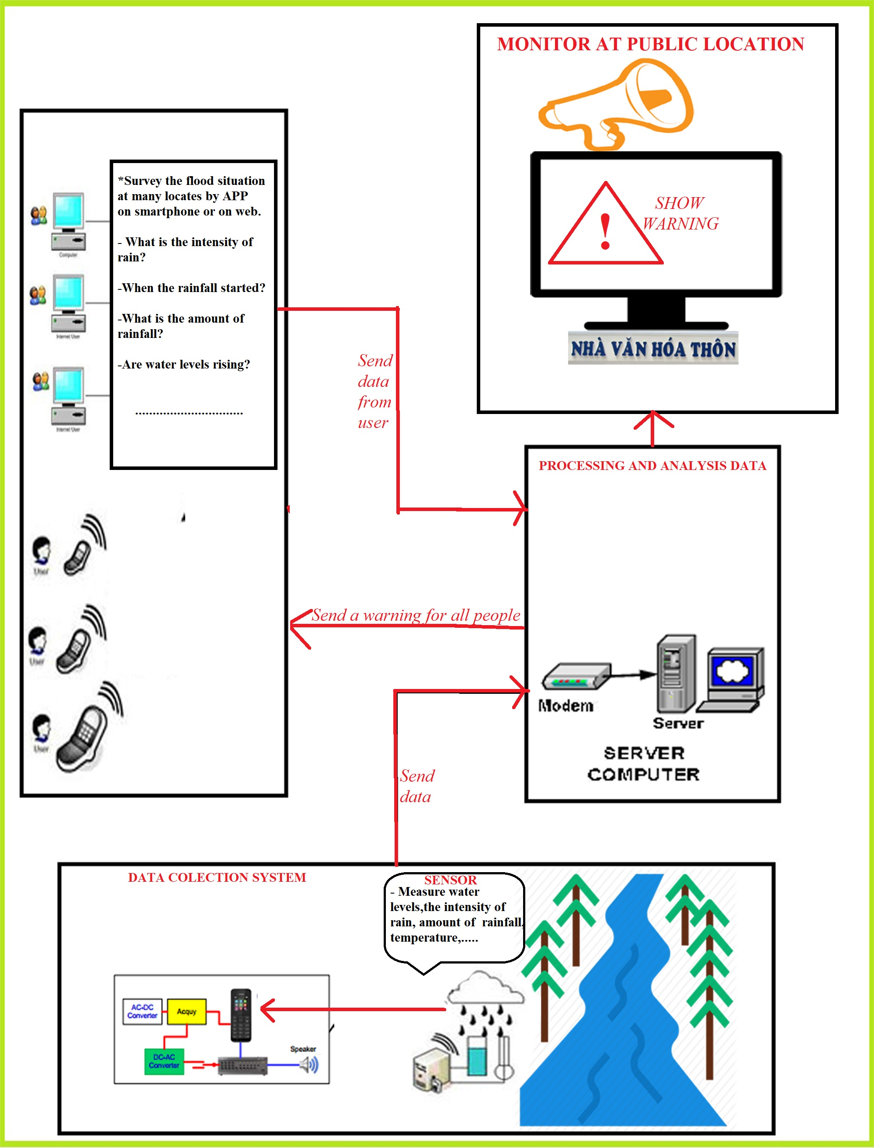

Slide 5
THANKS YOU!

